Slide 1




Enhanced Deep Residual Networks for Single Image Super-Resolution
Bee Lim, Sanghyun Son, Heewon Kim, Seungjun Nah, and Kyoung Mu Lee
Computer Vision Lab.
Dept. of ECE, ASRI, Seoul National University
http://cv.snu.ac.kr
Notes:
Hello everyone, I’m Bee Lim from Seoul National University.
Today I’m going to talk about “Enhanced Deep Residual Networks for Single Image Super-Resolution”.
This work is done by myself and Sanghyun Son, Heewon Kim, Seungjun Nah, and my advisor Kyoung Mu Lee.

Slide 2

SISR (Single Image Super Resolution)
Goal: Restoring a HR image from a single LR image
Super-Resolution
Low-resolution
image
High-resolution
image
Notes:
The goal of the single image super-resolution is to restore high-resolution image from its low-resolution counterpart.
We focused on maximizing the accuracy of SISR in terms of PSNR and SSIM.

Slide 3
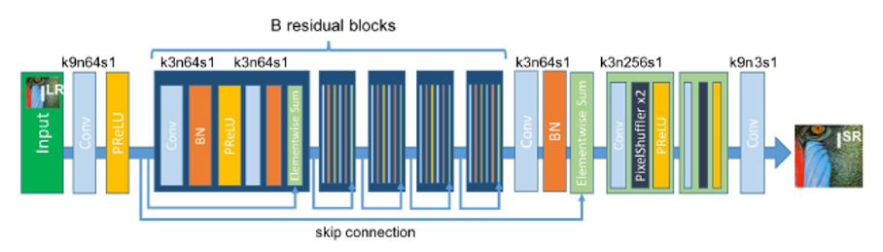
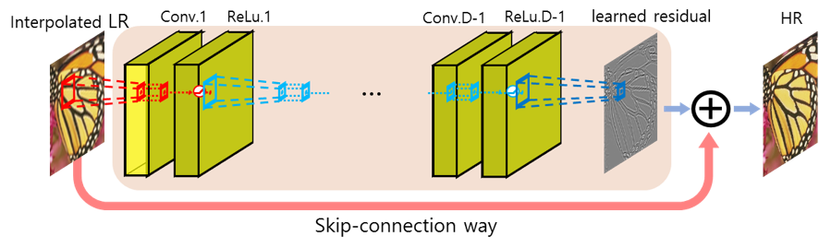
Lessons from Recent Studies
VDSR (CVPR2016)
SRResNet (CVPR2017)
Skip connections
Global and local skip connections enable deep architecture & stable training
Upscaling methods
Post-upscaling using sub-pixel convolution is more efficient than pre-upscaling
However, they are limited that only single-scale SR is possible
Notes:
We began from considering lessons from the previous works.
First, both global and local skip connections help training of deep CNN models.
We built our model based on residual modules.
Second, pre-upscaling enables multi-scale learning in a single model.
On the other hand, it is computationally efficient to use post-upscaling strategy, while we have to build a model for each scale.
Thus, in this work, we aimed to take advantage of both pre-upscaling and post-upscaling method.

Slide 4
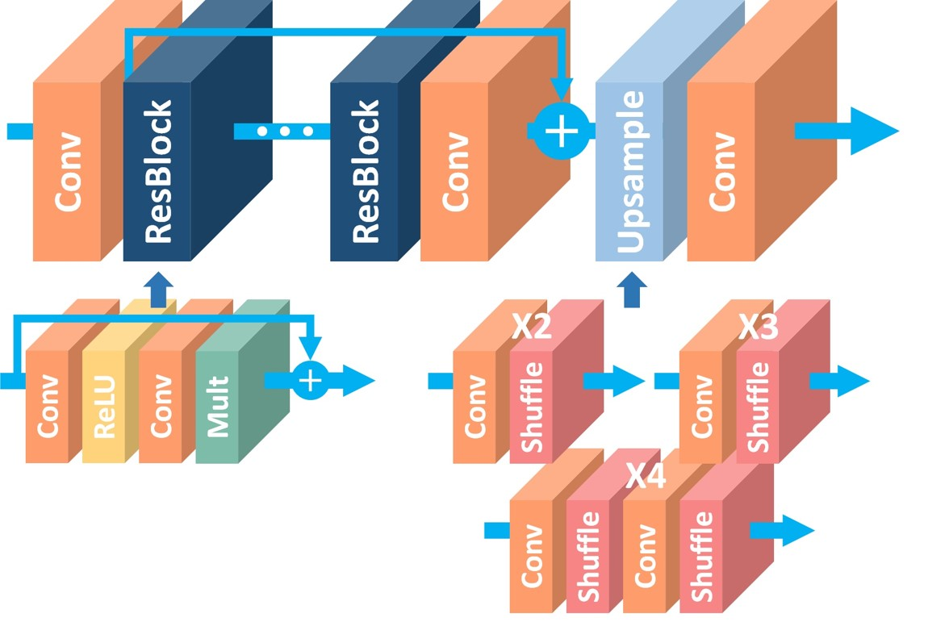
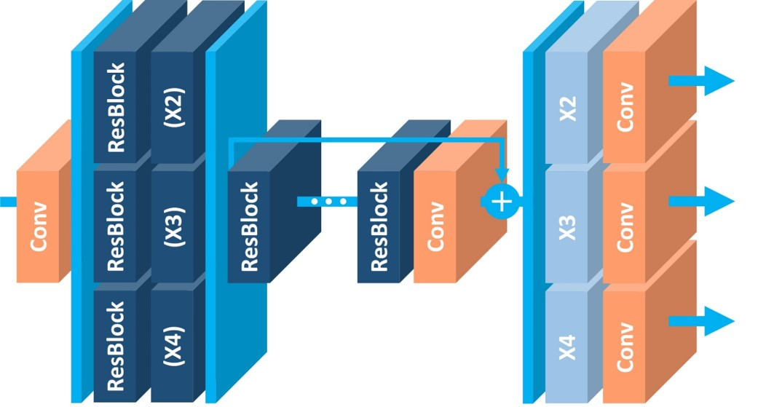
EDSR
MDSR
Notes:
From those two initiatives, we developed two different model architectures, namely EDSR and MDSR.
EDSR is an architecture dedicated to specific scale.
In contrast, MDSR is more compact and efficient architecture that can perform multiple-scale super-resolution in a single model.
We will explain them one-by-one..

Slide 5
EDSR
4 Techniques for Better SR
Need Batch-Normalization?
Increasing model size
Better loss function
Geometric self-ensemble
Notes:
Beginning with the SRResNet, we tried to modify the architecture to maximize the performance.
Here, we introduce 4 techniques to build and train our EDSR.

Slide 6
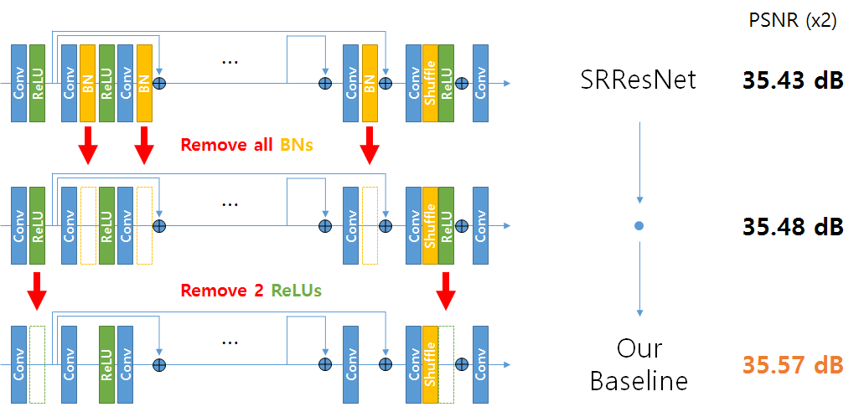
Need Batch-Normalization?
Empirical tests show that removing Batch-Normalization improves the performance!
Notes:
First, we revised in the basic resnet architecture.
As batch-normalization layers are linear and could be dumped into convolution layers, we tried removing them.
Surprisingly, the network provided better results without batch normalization layers.

Slide 7
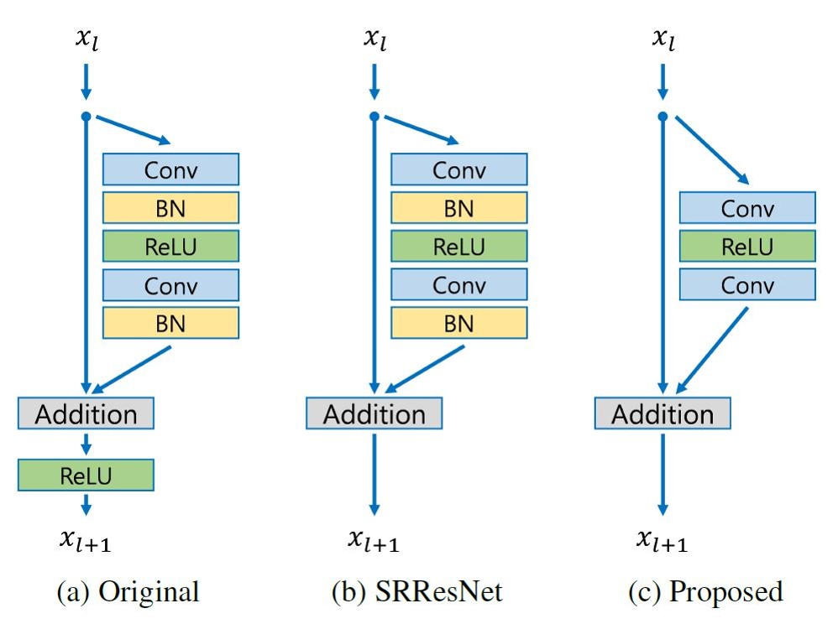
Need Batch-Normalization?
Unlike classification problem, input and output have similar distributions
In SR, normalizing intermediate features may not be desirable
Also, can save ~40% of memory → Can enlarge the model size
Notes:
So why we don’t need Batch-Normalization layers?
Unlike the original ResNet, we have similar distributions at the input and output of the network.
Batch-Normalization forces the intermediate layers to be normalized, thus make it difficult to estimate the target image.
As a side-effect, we could reduce GPU memory consumption by about 40%.
This gives us more headroom to stack more convolution layers.

Slide 8
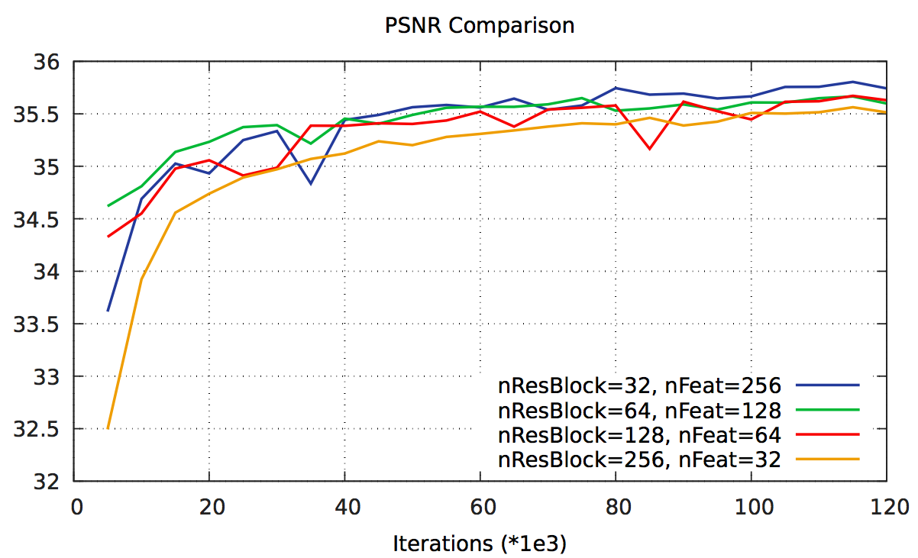
Increasing Model Size
Given a limited memory, which design is better?
Empirical test show that increasing #features is better than increasing depth
Instability occurs when #features increased up to 256
Notes:
During the challenge, our main concern was this question: When trained with single GPU memory, in which design, does our model performs best?
We designed the empirical tests of several configurations with the same memory consumption: 256 resblocks & 32 channels to 32 resblocks & 256 channels.
As you can see in this graph, increasing #channels achieves better PSNR than increasing model depth, #Resblocks.
However, if we increased number of feature maps up to 256, the training became unstable and we failed to produce good results.
Therefore, we applied additional technique which is called residual scaling.

Slide 9
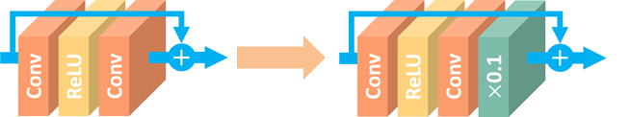
Increasing Model Size
Residual Scaling Layer
Increasing #features (up to 256) results instability during training
Constant scaling layers after each residual path prevents such instability
Proposed in (Szegedy 2016), “Inception-v4, Inception-ResNet and the Impact of Residual Connections on Learning”
Notes:
It has been reported in training Inception Network that when #features is too large, the value of each feature map becomes too small compared to gradient values.
This causes instability in training.
To avoid this issue, we simply multiplied a small constant after convolution to amplify the values of feature maps after convolution.

Slide 10
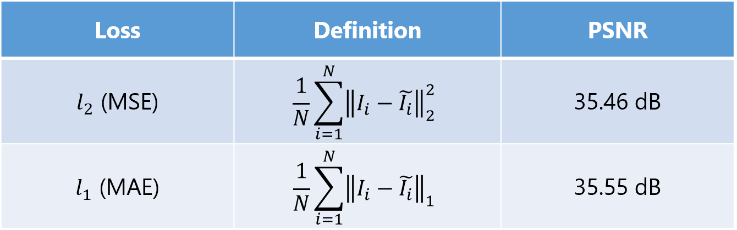
Loss Function: L1 vs L2
Is MSE (L2 loss) the best choice?
Comparison between different loss functions
EDSR baseline(16 res-blocks), scale=2, tested on DIV2K images (791~800)
→ MSE is not a good choice!
Notes:
Next, we compared different loss functions.
Although mean-squared error, the L2 loss, is the most widely used and directly related to PSNR, we found that mean absolute error, the L1 loss, works better when used as a loss function.
We have also compared other loss functions, such as those based on gradient, but they showed similar or worse performance than L1.
So we decided to use L1, which is simple and requires less computation.

Slide 11

Geometric Self-Ensemble
Motivation
Model ensemble is nice, but expensive!
How can we achieve an ensemble effect while avoiding training new models?
Method
Transform test image 8 times with flips and rotations (x8)
Build 8 outputs and inverse-transform correspondingly
Average 8 results
Proposed in (Timofte 2016), “Seven ways to improve example-based single-image super-resolution”
Notes:
The last technique we used is geometric self-ensemble.
One of the most popular technique to increase performance of a model is to do ensemble of different models.
However, training and saving several modes is time and space-consuming job.
Thus, we adopted an idea from the last year CVPR paper, ‘seven ways to improve example-based single-image super-resolution’.
In the test time, we first transform an input image using flips and rotations as shown in this figure, which is similar to training data augmentation.
Using a set of 8 transformed input images, we get the outputs, and inverse-transform each correspondingly.
We finally acquired the result by averaging those 8 outputs.

Slide 12
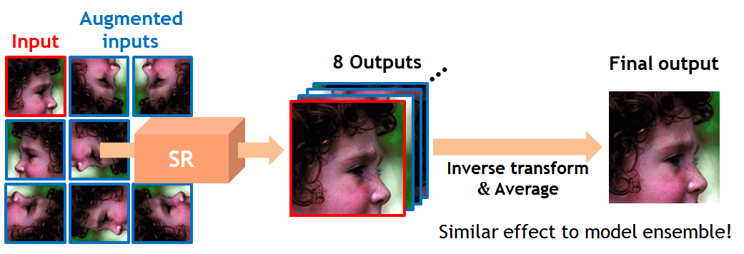
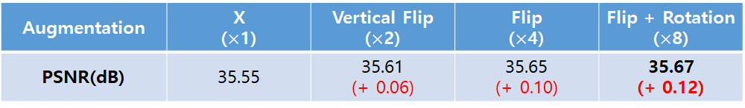
Geometric Self-Ensemble
Notes:
It has resulted in dramatic increase in performance without having to train the same model multiple times.
The more the averages with more transforms, the higher the performance.

Slide 13
EDSR Summary
Deeper & Wider: 32 ResBlocks and 256 channels
Global-local skip connections
Post-upscaling
No Batch-Normalization
Residual scaling
L1 loss function
Geometric self-ensemble (EDSR+)
Notes:
Here is the summary of EDSR.
In EDSR, we use both deeper and wider architecture to maximize the performance.
We use both global and local skip connections, and up-scaling is done at the end of the network.
We don’t use any BN layers, but instead use constant scaling layers to ensure stable training.
We use L1 loss function instead of L2, and finally in test time we conducts self-ensemble strategy.

Slide 14
EDSR
MDSR
Notes:
Next, Sanghyun Son will present the remaining parts.

Slide 15
MDSR
Motivation
VDSR: Multi-scale SR in a single model
Multi-scale knowledge transfer
Efficient Multi-Scale Model
Designing MDSR
Single vs. Multi-scale learning
Train & Test method
EDSR vs. MDSR
Notes:
Hello. My name is Sanghyun Son.
I will introduce our multi-scale architecture MDSR, which can handle multiple scales of super-resolution.

Slide 16
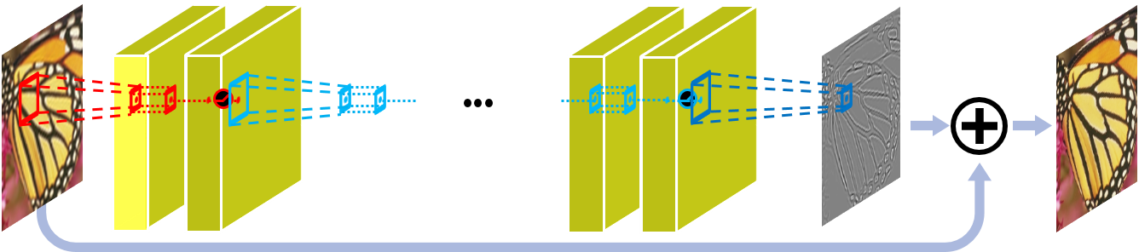
Motivation
SRCNN, VDSR: A single architecture regardless of upscaling factor
⇨ Multi-scale SR in a single model (VDSR)
FSRCNN, ESPCN, SRResNet: Fast & Efficient, (late upsampling) but cannot deal with the multiple scales in a single model.
Notes:
Early deep-learning based super-resolution methods such as SRCNN & VDSR have a single architecture regardless of their upscaling factor, because they use pre-upscaling methods.
VDSR from the last CVPR, successfully utilized this property and enabled multi-scale super-resolution.
Compared to earlier methods, many of the current super-resolution algorithms depend on post-upscaling strategy.
These methods are much efficient in terms of speed and memory, but the architecture should be changed if the upscaling factor varies.

Slide 17
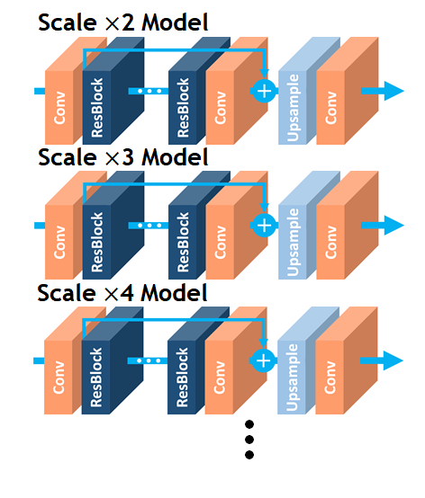
Motivation
FSRCNN, ESPCN, SRResNet
⇨ Different models for different scales?
Heavy training burden
Waste of parameters for similar tasks
Redundancy
Notes:
EDSR also uses post upsampling strategy, and its architecture is scale-specific, too.
The problem is, EDSRs with different upsampling factors do not share their knowledge while they all do the similar tasks.
Therefore, having multiple EDSRs of various scales is very inefficient, and there exists a huge redundancy.

Slide 18
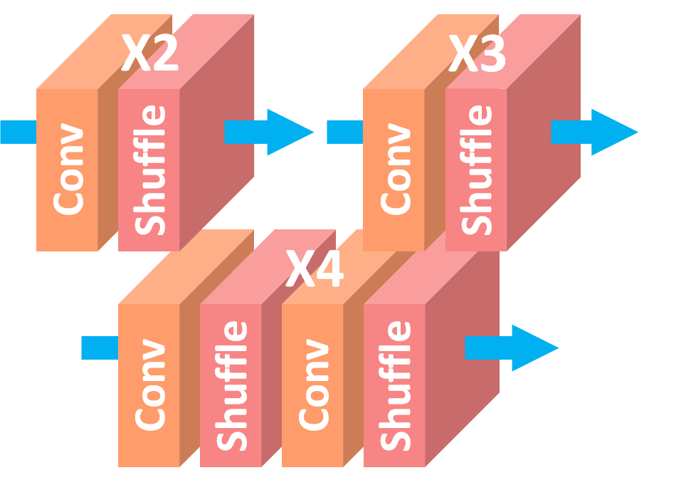
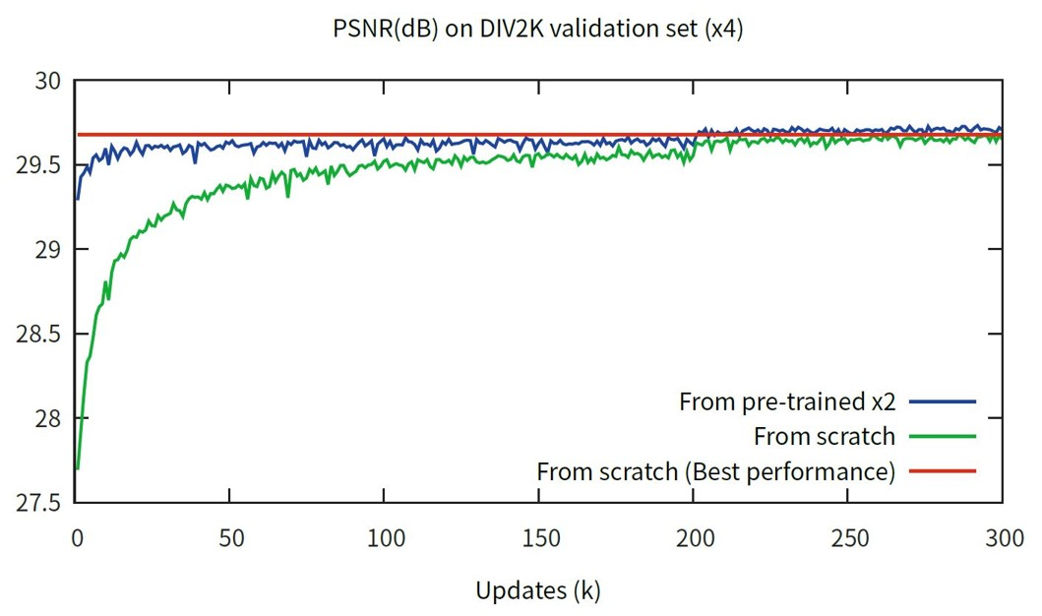
Motivation
Pre-trained scale x2 networks greatly helps training scale x3 and x4 networks.
Super-resolution at multiple scales are inter-related tasks!
Multi-scale knowledge transfer
Notes:
Fortunately, we could find an evidence that the multi-scale learning can solve our problem.
When training EDSR of scale x3 and x4, we initialized them with pre-trained scale x2 model and changed the upsampler only.
Those models converged 5 times faster than the randomly initialized networks.
In the graph, you can check that the pre-training greatly helps the training of scale x3 and x4 networks, by comparing blue line and green line..
As a result, we concluded that the super-resolution at multiple scales are inter-related tasks.

Slide 19
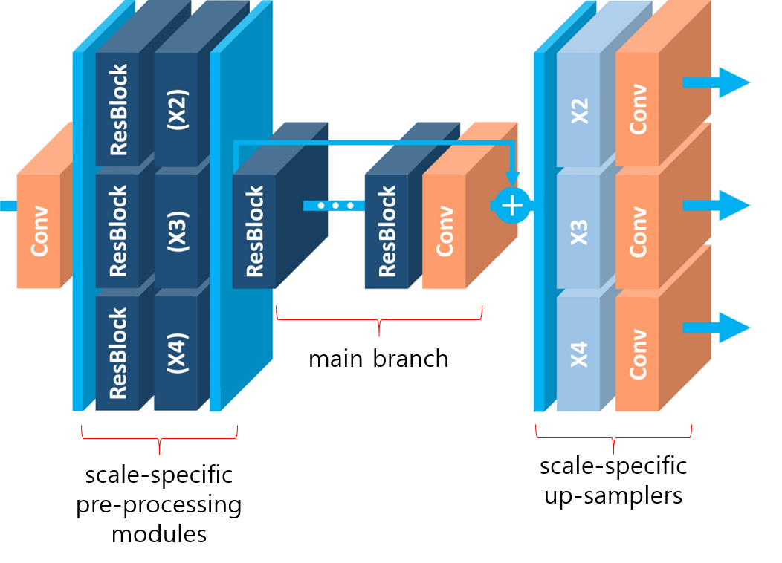
Designing MDSR
How to make EDSR (post-upscaling) to handle multiscale SR as VDSR?
Requirements
Reduce the variance between the different scales
Most parameters are shared across scales
For efficiency: Post-upscaling
⇨ Scale-specific pre-processing modules
⇨ main branch
⇨ Scale-specific up-samplers
Notes:
This is our proposed model, MDSR. It mainly consists of three parts.
The first part is the scale-specific preprocessing modules. They reduce the variance between different scales of training images, and make the system more stable.
The second part is the main branch, and the most of the parameters are shared across all the scales.
The last part is the scale-specific upsamplers, which reconstruct the output images of desired resolution.
Note that we can even extend our model by just adding the appropriate scale-specific modules and fine-tune the network.

Slide 20
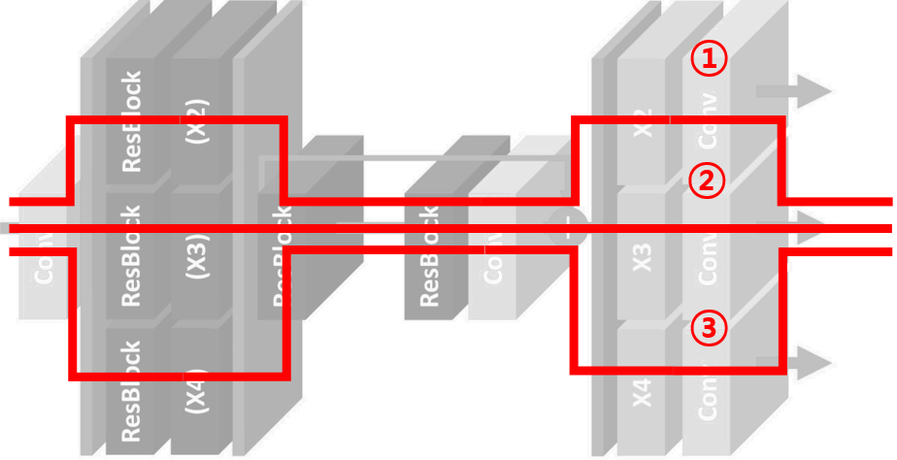
Train and Test Method
Train
Only one of 3 scale-specific branches is activated at each iteration
A mini-batch consists of single-scale patches
Test
Select one of the paths (①~③) according to the desired SR scale
Notes:
You might wonder how to train MDSR.
When training MDSR, we randomly select the scale and compose the mini-batch of single-scale input-target pairs per each iteration.
We then activate only one of the scale-specific branches and feed the mini-batch through the activated path.
In the back-propagation step, only parameters in the selected branch are updated, and we repeat the process until the convergence.
During the test time, we select one of the 3 paths we want, and upscale the input image.

Slide 21

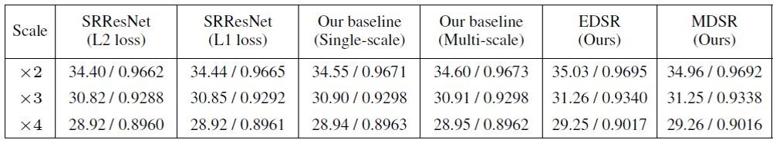
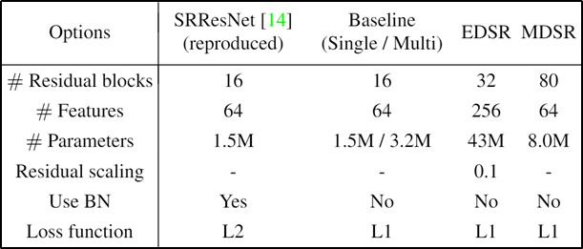
EDSR vs. MDSR
Performance: MDSR ≲ EDSR
# Parameters: MDSR << EDSR (Almost ⅕! + MDSR can handle the multiple scales in a single model)
Stability: MDSR << EDSR (We failed to increase #features even with residual scaling)
Notes:
Here, we compare our two models.
MDSR has almost one fifth of the parameters compared to EDSR, but it has a comparable performance.
However, stability was an issue.
Although we expect that MDSR can perform better if the network becomes larger, we failed to increase the number of features even with the residual scaling.
Therefore, we only increased the number of residual blocks in MDSR.

Slide 22
MDSR Summary
Very deep architecture: 80 ResBlocks
Most parameters are shared in main branch
Scale-specific pre-processing modules and up-samplers
Post-upscaling
No Batch-Normalization
L1 loss function
Geometric self-ensemble (MDSR+)
Notes:
This is a summary.
In MDSR, we used a very deep architecture instead of the wide one for stability.
MDSR consists of three parts, and most of the parameters are shared in the main branch.
As a result, we implemented multi-scale super-resolution in an efficient way..
Other details are same as the EDSR, as we explained just before.

Slide 23
Results
Notes:
Next, we will show you some quantitative and qualitative results.

Slide 24
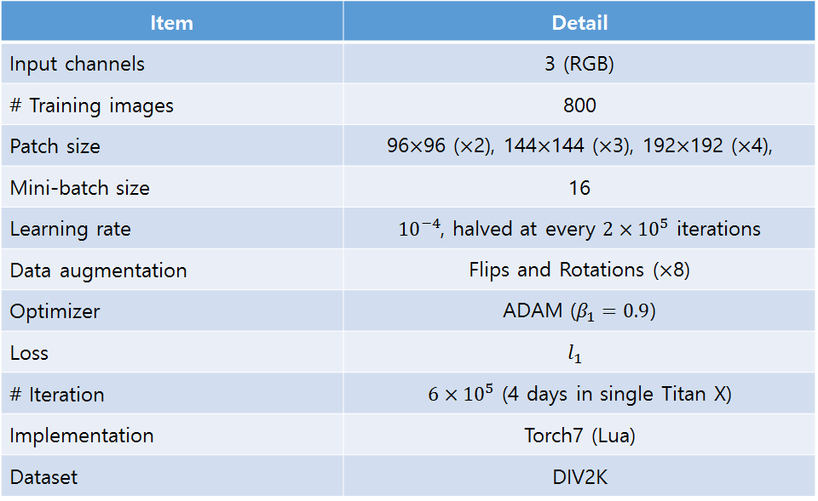
Training Details
Notes:
This is our training details. We used torch7, and our code is available online.

Slide 25
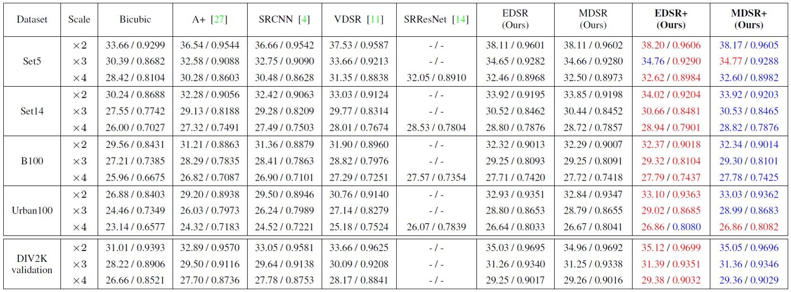
Quantitative Results
Notes:
We provide the test results on major super-resolution benchmark datasets.
Our EDSR+ and MDSR+, which are self-ensemble version of our models, win all the other methods by a large margin.

Slide 26
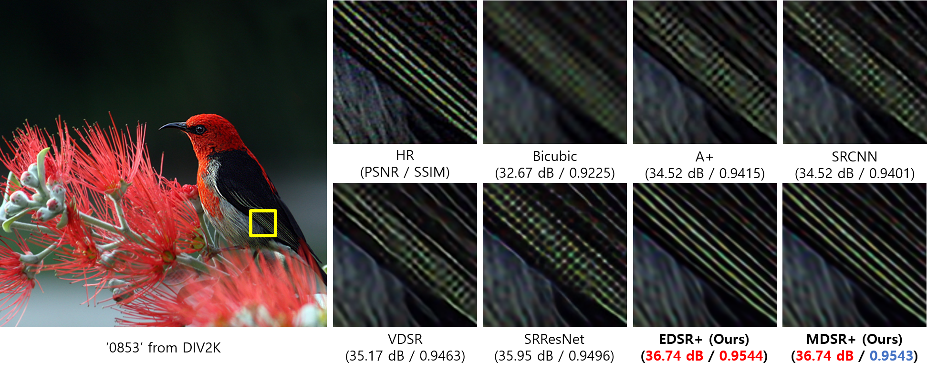
Qualitative Results
Notes:
We also provide some qualitative results. As you can see in this picture, our methods reconstruct the structured image very well.

Slide 27
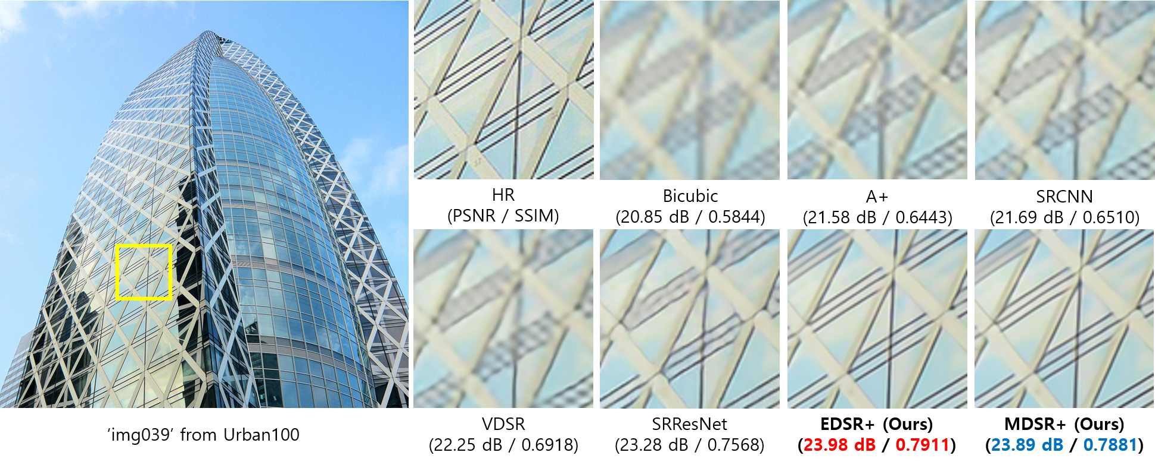
Qualitative Results

Slide 28
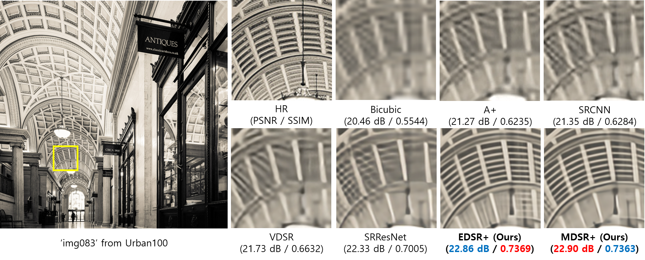
Qualitative Results

Slide 29
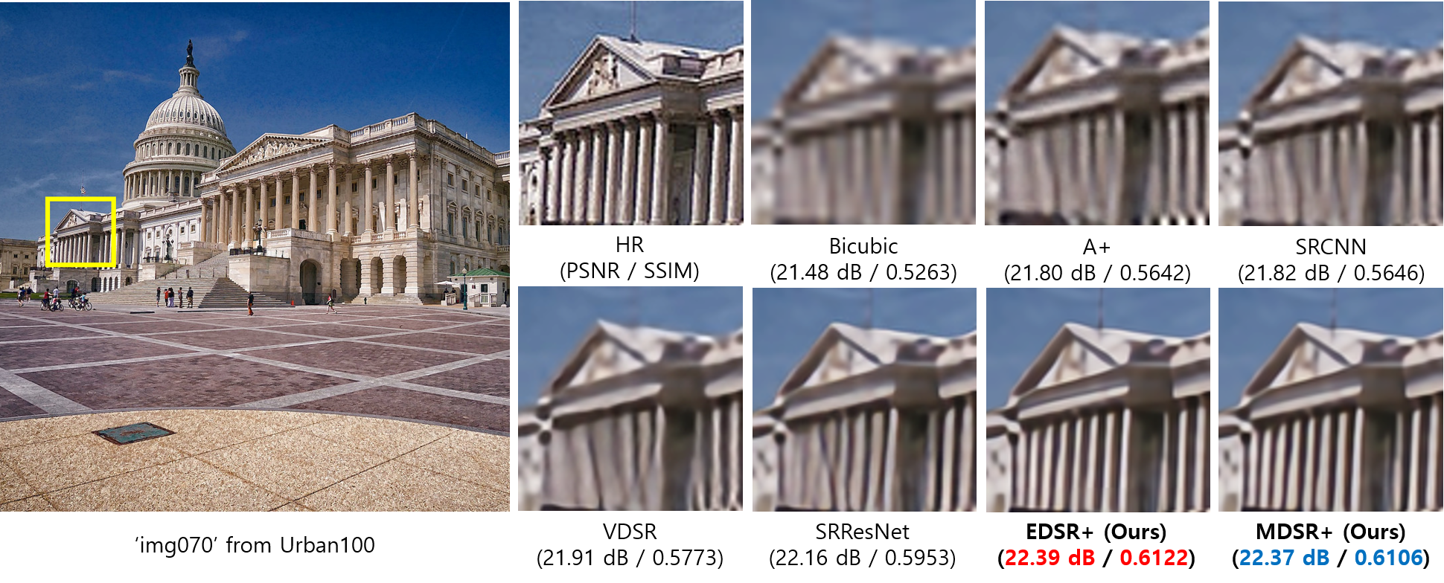
Qualitative Results
Notes:
In this results, all the other algorithms failed to reconstruct the pillar in the temple. On the other hand, our algorithms reconstruct the structure without distortion.

Slide 30
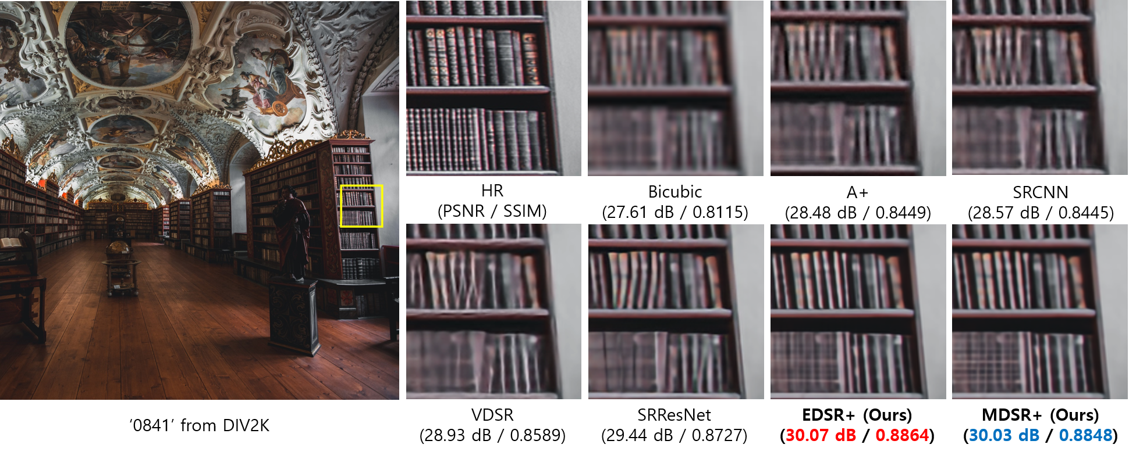
Qualitative Results
Notes:
And, these results are very impressive, too.

Slide 31
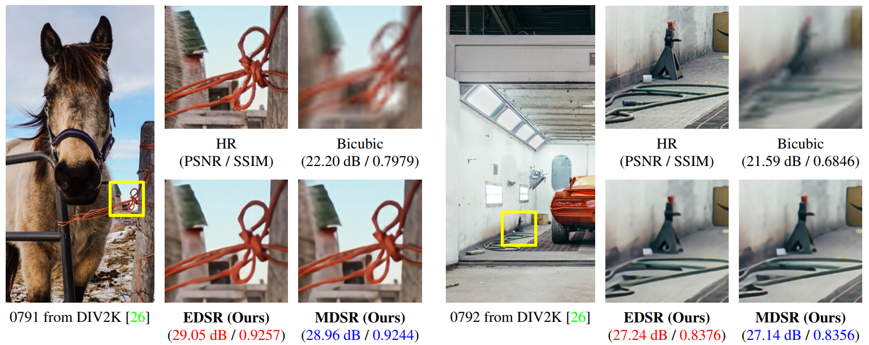
Unknown Track (Challenge)
Notes:
These results are from unknown track of NTIRE2017 super-resolution challenge. You can check that our methods can be generalized into more challenging tasks.

Slide 32
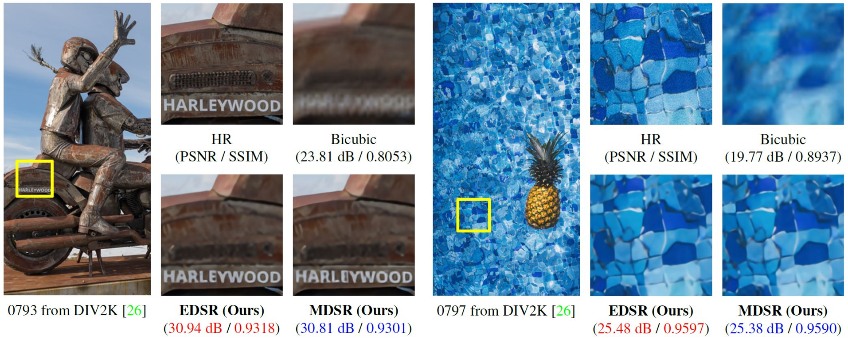
Unknown Track (Challenge)

Slide 33

Extreme SR (up to x64)
How about extreme cases?
1/64 Scale!
Notes:
EDSR and MDSR work quite well in scale 4 upscaling.
So we tried extreme case super resolution up to scale 64 with EDSR.

Slide 34



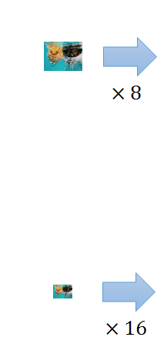



Extreme SR (up to x64)
NN
Bicubic
EDSR
Notes:
Nearest Neighbor interpolation shows how much the input loses the image details at presented output resolution

Slide 35
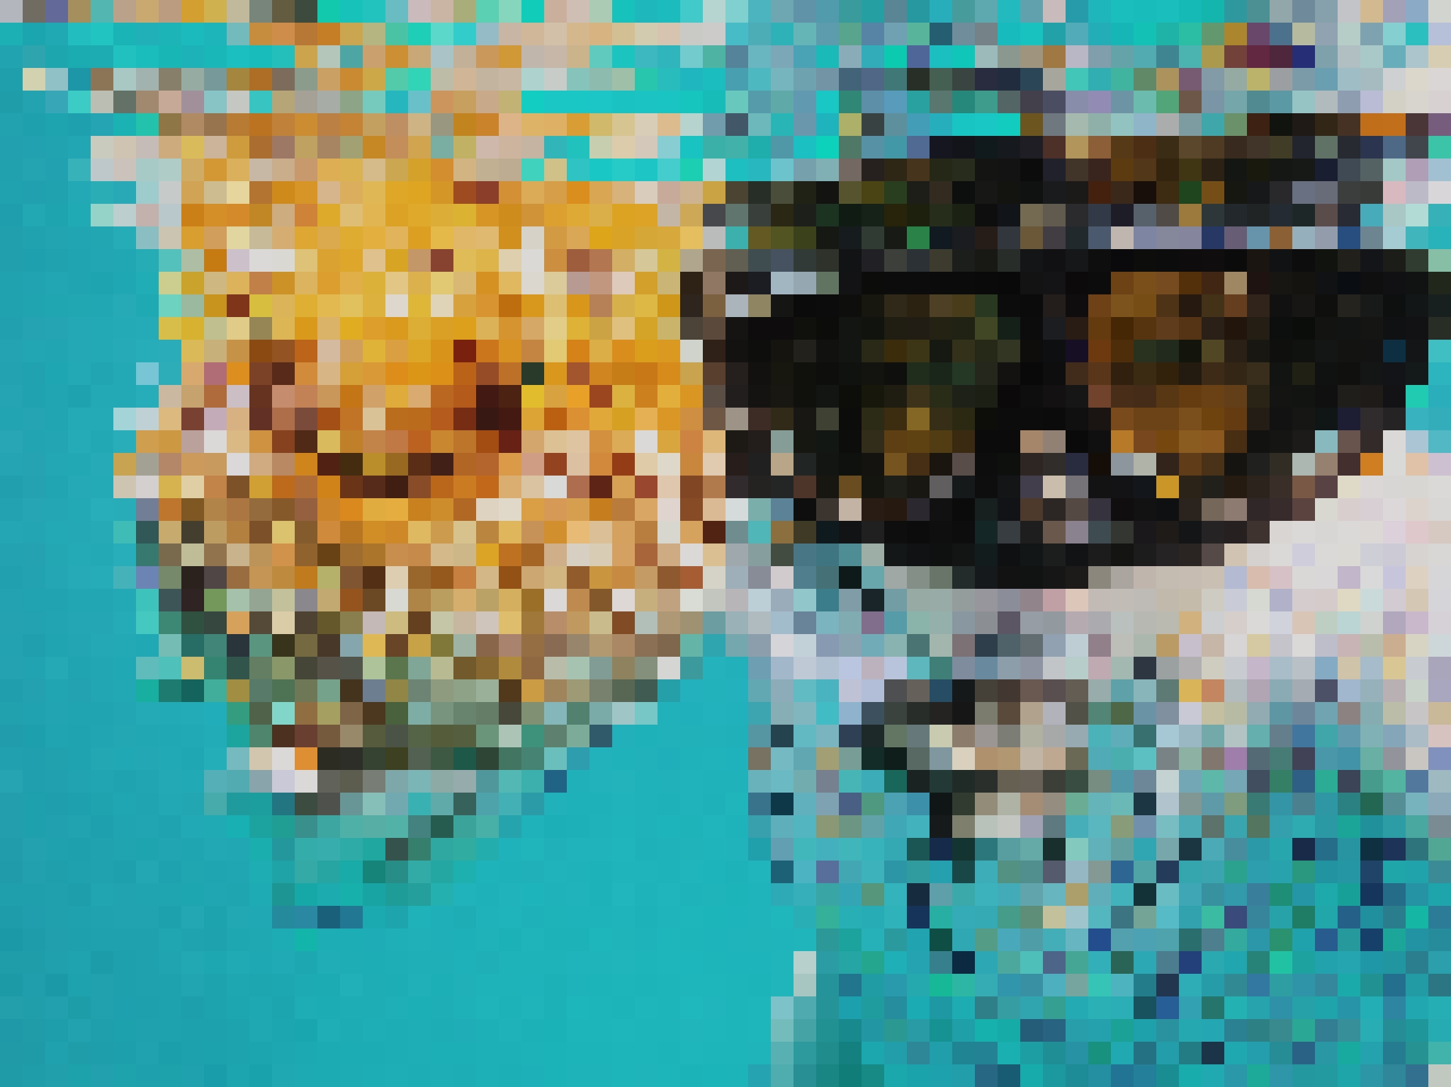


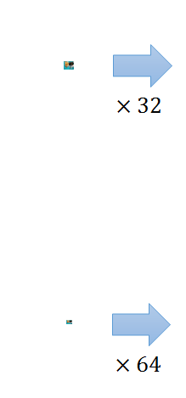



Extreme SR (up to x64)
NN
Bicubic
EDSR
Notes:
As you can see, EDSR maintains quite good results until scale 32 upsampling.
However, in scale 64 upscaling, the image details are no more left
We think that extreme super resolution is very challenging and interesting problem.

Slide 36
Conclusion
State-of-the-art single image super-resolution system using better ResNet structure
Techniques to build & train extremely large model
A single network to deal with multi-scale SR problem
Notes:
These are conclusions.
First, we implemented the state-of-the art single image super-resolution with enhanced residual structure.
We also provide some techniques for building large models and further enhance their performance.
Finally, we propose multi-scale network that can deal with various scales of super-resolution.

Slide 37
Thank you!
http://cv.snu.ac.kr

